Slide 1
GLMs for
Binary data
We are now going to consider dichotomous categorical response variables. We will denote Y with a 1 or 0. Typically, we use that Y=1 for a “success” and Y = 0 for a “failure”.
Then Y has a Bernoulli distribution with p(Y)=1 = π and p(Y)=0 = 1-π.
E(Y)= π and Var(Y)= π(1- π)
For n i.i.d. Bernoulli Y variables, the number of successes has a binomial distribution with parameters π and n. Note, the number of successes is equal to the sum of the n Bernoulli Y variables.

Slide 2
GLMs for
Binary data
Typically we are interested in inference on π. Such as estimating the probability a drug works π. And note, the probability that the drug does not work is 1- π.
We will see later that most inference is done in terms of odds. The odds of success are defined as the probability of success divided by the probability of failure. That is
Odds = π/(1- π)
Thus, the odds would be the probability the drug works divided by the probability the drug does not work. Odds ratios are ratios of two odds. For example, the odds of success that the drug works for men over the odds of success that the drug works for women.

Slide 3
GLMs for
Binary data
We will now model π as a function of explanatory variables.
We start with 1 explanatory variable, X.

Slide 4

GLMs for Binary data
A model analogous to ordinary regression is
This is a linear probability model since the probability of success changes linearly in x.
β gives the slope, how much the probability of success changes for a one unit increase in x.
However, for values of x small and large enough, π will be less than 0 or larger than 1.

Slide 5
Newton- Raphson
Algorithm
To fit this, as well as other models, the Newton-Raphson algorithm is used to estimate the mles.
The mle is the value of the parameter that maximizes the likelihood function (or log-likelihood function).
The algorithm starts with an arbitrary guess.
It then approximates the log-likelihood function to be maximized in the neighborhood of this guess with a parabola.

Slide 6
Newton- Raphson
Algorithm
The value of the parameter that maximizes the parabola is then taken to be the next “guess” and the log-likelihood is approximated by another parabola in the neighborhood of this guess.
This process continues until the algorithm converges on a point which is then used as the estimate of the mle.
R code (NR)

Slide 7
Logistic Regression Model
Relationships between π and x are usually nonlinear.
Consider buying a car and the choices are either buying a new one or a used one.
Let π be the probability of buying a new car for family income of x.
If family income, x, increases by 50,000$, how would this effect the probability of buying a new car, π?

Slide 8
Logistic Regression Model
If the current family income is 10,000,000$, how would increasing it by 50,000$ effect π?
If the current family income is 10,000$, how would increasing it by 50,000$ effect π?
If the current family income is 100,000$, how would increasing it by 50,000$ effect π?

Slide 9
Logistic Regression Model
Often changes in x, have little effects in changes in π when π is near 0 or 1. But they can have large effects when π is in the middle of the range.
This gives a nonlinear relationship between π and x.
Often as x increases, π increases or decreases continuously in an S shaped curve.

Slide 10
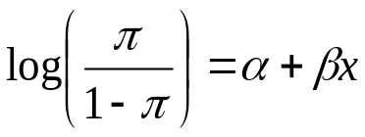
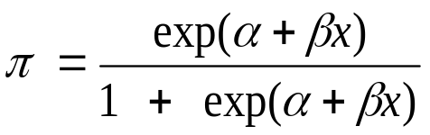
Logistic Regression Model
The model with this S shape for π is the logistic regression (logit) model
For this model, we have that

Slide 11
Logistic Regression Model
The parameter β determines if the S shaped curve is increasing or decreasing.
For β > 0, the curve is increasing and for β <0 the curve is decreasing.
The magnitude of β determines how fast. The larger |β| is, the faster the rate of change.

Slide 12
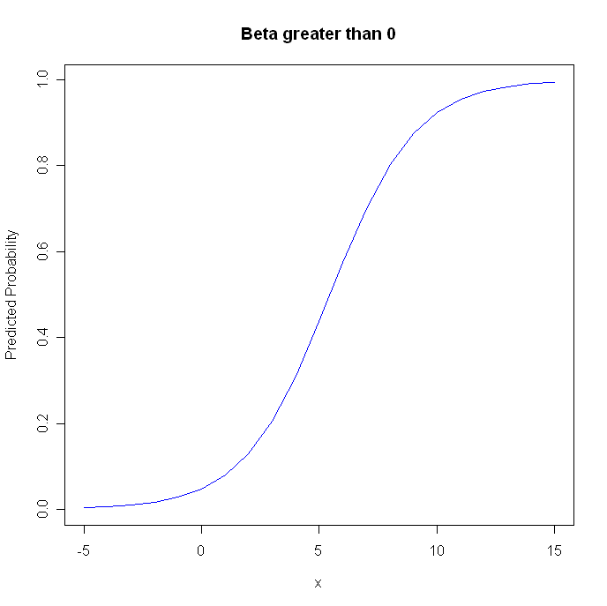

Slide 13
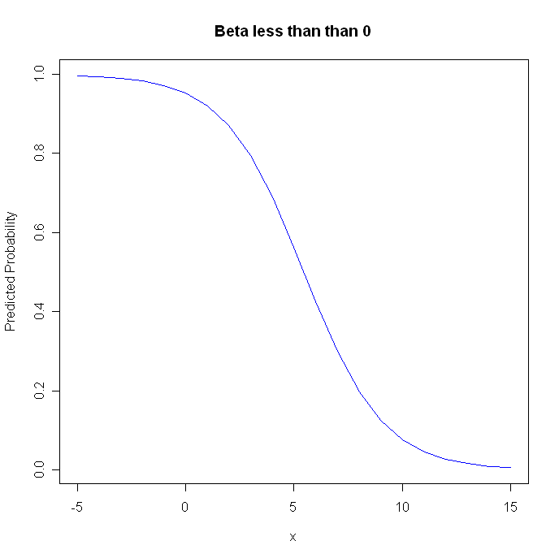

Slide 14
Logistic Regression Model
If β=0, what does the curve look like?

Slide 15
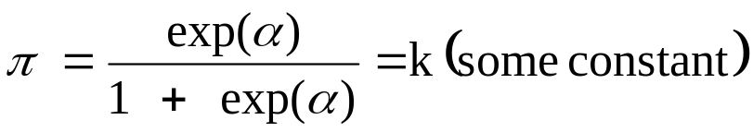
Logistic Regression Model
If β=0, then
In this case, the probability of success is the same for any value of X and X and π are independent.
Here, the plot of π would be a straight line. At all values of x, π = k.
If β is not 0, this indicates that X has an effect on the probability of success.

Slide 16
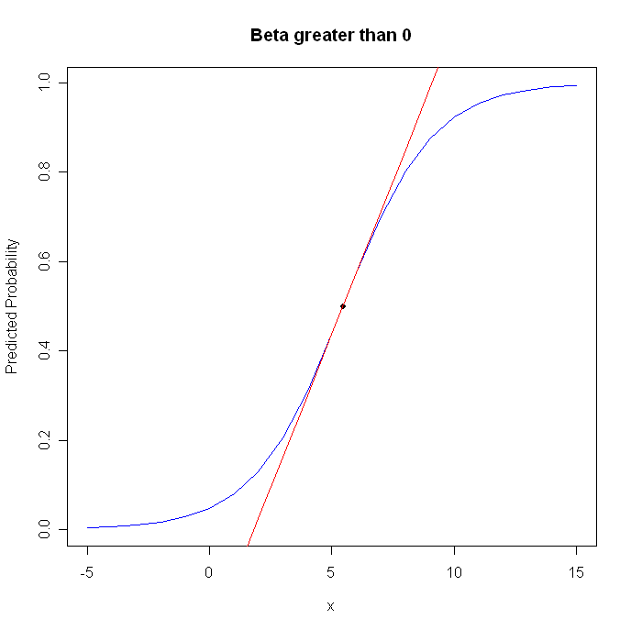
Logistic Regression Model
To determine the rate of change of the S shaped curve, the predicted probabilities, at a particular value of x, we can draw a straight line tangent to the curve at that value of x.

Slide 17
Logistic Regression Model
At a particular value of the predictor variable x, the tangent line has slope β π(1-π) for the value of π that corresponds with that value of x.
This describes the rate of change of the S shaped curve at x.
There is a value of x such that π = .5. At this value of x, the tangent line has slope β(.5)(.5)= .25 β.
The slope of the tangent line, and thus the rate of change of the S shaped curve, gets smaller as π gets farther away from .5. So the slope is maximized at the value of x for which π = .5.

Slide 18
Logistic Regression Model
We will use the crab data for examples. Y=1 if a crab has at least 1 additional satellite and Y=0 if a crab has no additional satellites.
Explanatory variables include color of the crab, age, and shell width.
For now, we will consider shell width, which is continuous.

Slide 19


Logistic Regression Model
π is the probability of a crab having a satellite. The easiest model is the linear probability model
For this fitted model, we have
What is the interpretation of this model and what is the probability of a satellite for a crab of width 33.5?

Slide 20
Logistic Regression Model
For every 1 cm increase in width, the probability of a satellite goes up by .092.
For a width of 33.5, the estimated probability of a satellite is: 1.766+.092(33.5) = 1.3.
Probabilities can’t be greater than 1, so we will use the logit model instead.

Slide 21
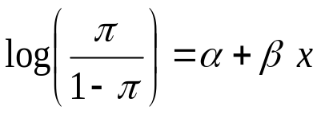
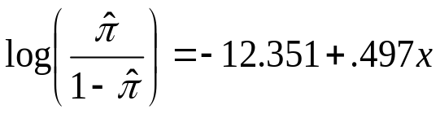
Logistic Regression Model
We now use the logistic regression (logit) model
And the fitted model is
For this model, what is the probability of a satellite for a crab with width 33.5?

Slide 22
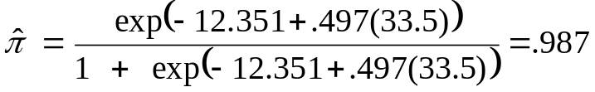
Logistic Regression Model
For a width of 33.5, the estimated probability of a satellite is
Does the predicted probability go up or down as x increases?
Since β(hat)>0, it goes up.

Slide 23
Logistic Regression Model
The smallest width in the data is 21. Here the predicted probability is .129.
The sample mean width in the data is 26.3. Here the predicted probability is .674.
The slope of the S shaped curve, the predicted probabilities, is estimated by βπ(1-π). What is the estimated slope for the smallest value of x, the mean value of x, and the largest value of x (33.5)?

Slide 24
Logistic Regression Model
For the smallest value of x, 21, the estimated slope of the S shaped curve is .497(.129)(1-.129) = .056
For the sample mean value of x, 26.3, the estimated slope of the S shaped curve is .497(.674)(1-.674) = .11
For the largest value of x, 33.5, the estimated slope of the S shaped curve is .497(.987)(1-.987) = .006

Slide 25
Logistic Regression Model
The rate of increase changes for different values of x.
The slope is steepest when the predicted probability is near .5 and the closer to 0 or 1 the predicted probability is, the smaller the rate of change.
For linear models, the rate of increase is constant over all of x.

Slide 26
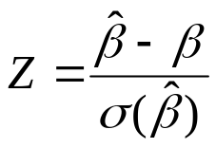
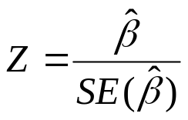
Logistic Regression Model
As with the Poisson models, Beta(hat) is distributed normal and we have that
follows a standard normal distribution.
To test if width has an effect on the probability of a crab having any satellites, the null is H_{o}: β = 0. Our test statistic, which uses the estimated standard error of β(hat), is then

Slide 27
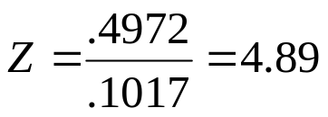
Logistic Regression Model
Again, even though the standard error of β(hat) is estimated, we still use the z distribution and not the t.
Also, similar with Poisson regression, the chi-square distribution is often used (such as with SAS). When the z statistic is squared, this gives a chi-square statistic with 1 degree of freedom.
For the crab example we have that
The chi-square statistic equals z squared which is 4.89^2=23.9. Both statistics will give the exact same p-value which here is <.0001. SAS (Logreg1)

Slide 28
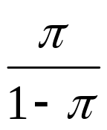
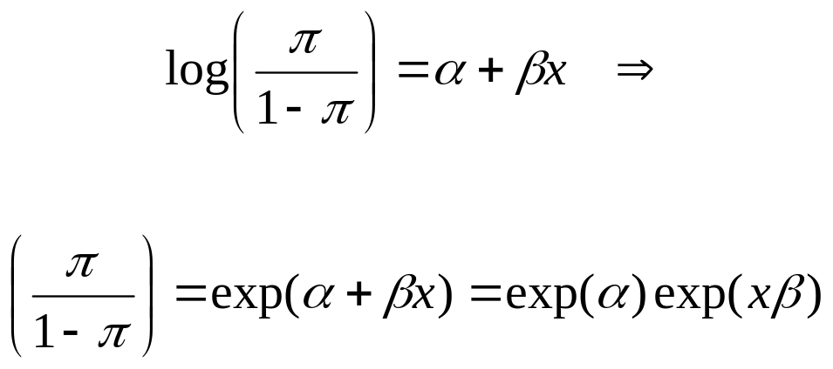
Logistic Regression Models
The odds of success is the probability of success divided by the probability of failure:
And

Slide 29
Logistic Regression Models
An odds ratio is the ratio of two odds. Here we look at the odds of success at a value of x over the odds of success at a different value of x. Note, if x is categorical (dummy coded), this is the odds of success for one category over the odds of success for a different category.
Suppose we have two observed values of x: x=5 and x=4. What is the odds ratio for the odds of success at these two levels of x?
Thus exp(β) is the odds ratio for x=5 over x=4.

Slide 30
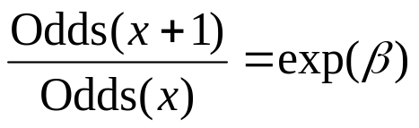

Logistic Regression Models
In general,
and exp(β) is the odds ratio for a one unit increase in x.
Or
The odds increase multiplicatively by exp(β) for every unit increase in X.

Slide 31
Logistic Regression Models
Crab data: β(hat) = .497. So for every 1 cm increase in width, the odds increase by?
exp(β(hat))=exp(.497)=1.64. So for every unit increase in width, the odds increase by 1.64 times as much.
For the mean width, X=26.3, the odds are .674/(1-.674) = 2.07
For X=27.3, a one unit increase in X, the odds are .773/(1-.773) = 3.4
And note, 2.07*1.64 = 3.4, thus the odds increased multiplicatively by exp(β(hat)) = 1.64.

Slide 32
Logit model for categorical predictors
Let Y be a binary response variable taking values 1 for “success” and 0 for “failure” as before.
Let X and Z be categorical explanatory variables with two levels (categories) each.
Let X and Z each take the values 0 or 1 to represent the categories of each explanatory variable.

Slide 33
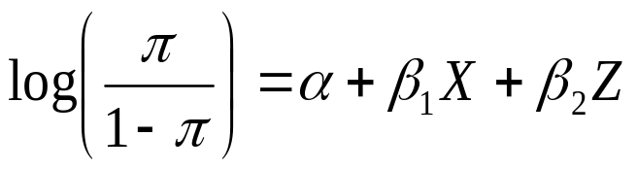
Logit model for categorical predictors
The logit model with no interaction is
No interaction means the effects of one explanatory variable are the same regardless of the level of the other explanatory variable.
For example, the effect that a treatment has on the probability of curing acne is the same for both men and women.

Slide 34
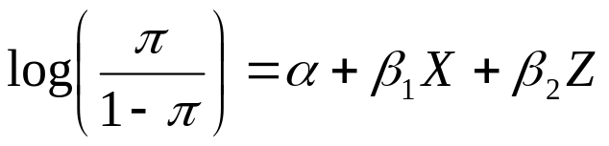
Logit model for categorical predictors
X and Z are dummy variables, they are either 1 or 0.
X= | Z= | Logit=
0 | 0 | α
1 | 0 | α+ β₁
0 | 1 | α+ β₂
1 | 1 | α+ β₁+ β₂

Slide 35
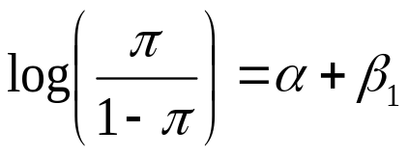

Logit model for categorical predictors
X and Z are dummy variables, they are either 1 or 0. For example, let X=1 for females and 0 for males. Let Z=1 for treatment and 0 for placebo.
For females on the placebo:
For males on the treatment:

Slide 36
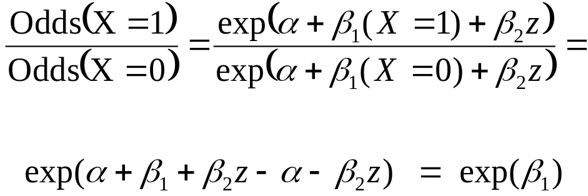
Logit model for categorical predictors
The odds ratio for X=1 over X=0, for a fixed level of Z, is
Thus exp(β₁) is the conditional odds ratio, the odds of success at X=1 over the odds of success at X=0, controlling for Z.
Or here, exp(β₁) is the conditional odds ratio, the odds of success for females over the odds of success for males, controlling for treatment.

Slide 37
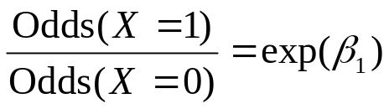
Logit model for categorical predictors
Again, exp(β₁) is the conditional odds ratio, the odds of success at X=1 over the odds of success at X=0, controlling for Z.
No interaction indicates a common odds ratio at each level of Z.
That is the odds of success for female over male is the same for when Z= treatment as when Z= placebo.

Slide 38
Logit model for categorical predictors
Race | AZT | Yes | No
White | immed | 14 | 93
White | delayed | 32 | 81
Black | immed | 11 | 52
Black | delayed | 12 | 43
Veterans with Aids were assigned to either receive AZT immediately or for there to be a delay before they received AZT.
The race of the veterans and whether they developed symptoms (Yes or No) was also recorded.

Slide 39
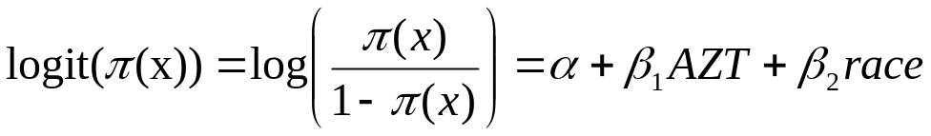
Logit model for categorical predictors
We are modeling the probability of symptoms based on race and AZT. The model is
where AZT = 0 for immediate AZT and 1 for delayed AZT.
β₁(hat) = .72 (SE = .279)
The odds ratio for the odds of getting symptoms for delayed AZT over the odds of symptoms for immediate AZT, controlling for race, is?

Slide 40
Logit model for categorical predictors
Estimated Odds Ratio = exp(β₁(hat) ) = exp(.72)=2.05
The odds of symptoms is about twice that for those on delayed AZT than for those on immediate AZT, controlling for race.
Is the effect of AZT, controlling for race, significant?
H_{o}: β₁ = 0; A Wald test statistic is z = β₁(hat)/SE(β₁(hat)) = .72/.279 = 2.58 (p=.01)
SAS gives results for a chi-squared test. Note z squared equals the chi-squared statistic. Thus chi-square = 2.58^2 = 6.65
SAS:logreg2

Slide 41
ANOVA-type model
For an X with two levels, we denote β^{x_1} as the β corresponding to the first level of X and β^{x_2} as the β corresponding to the second level of X.
For parameterizing the model, we can use β^{x_1}=0, β^{x_2} =0, or β^{x_1} + β^{x_2} =0. Using, β^{x_1} + β^{x_2} =0, corresponds so that X=1 in category 1 and X =-1 in category 2.
For any of these three parameterizations, the difference between β^{x_1} and β^{x_2}, that is β^{x_1} - β^{x_2}, is the same.
The difference β^{x_1} - β^{x_2} is the conditional log odds ratio between x₁ and x₂, given Z, and exp(β^{x_1} - β^{x_2}) is the conditional odds ratio between x₁ and x₂, given Z

Slide 42
ANOVA-type model
By itself, the parameter estimate for a single category of a factor is irrelevant.
Different parameterizations produce different estimates.
An estimate makes sense only by comparing with one from another category.
And again, regardless of which parameterization is used, the difference in the parameters is the same.

Slide 43
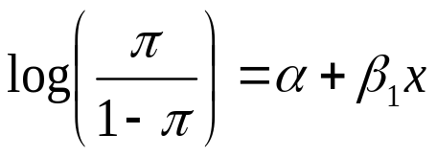
ANOVA-type model
A factor with two levels only needs 1 dummy variable. The model only has 1 additional parameter besides the intercept.
X is either 1 or 0, indicating which of the two levels the subject falls into. For instance, we could have x = 0 for male and 1 for female.
Similarly, if we have I levels of a factor, we only use I-1 indicator variables in our model where the level not used is the baseline level.

Slide 44
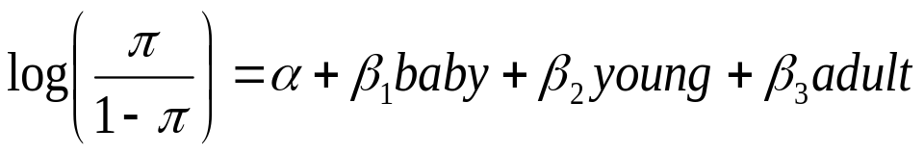
ANOVA-type model
The logistic regression (logit) model for categorical variables can be extended to variables with more than two levels.
For example, if we model the probability of eating pizza for 4 age groups (baby, young, adult, senior) we could set the model as
where baby=1 if subject is a baby, 0 otherwise
young=1 if subject is a young person, 0 otherwise
adult=1 if subject is an adult, 0 otherwise

Slide 45
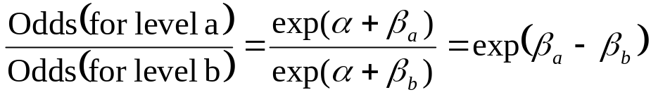
ANOVA-type model
Exponentiating the difference between Betas for two levels of a factor gives the odds ratio for the odds of success in the first level over the odds of success in the second level.
By first level, this simply means the level corresponding to the Beta that is first when taking the difference of the Betas.
To see this, note for two levels of X, say “a” and “b”, with corresponding Betas β_{a} and β_{b}

Slide 46
ANOVA-type model
In our pizza example, suppose, β₁ (corresponding to baby) is 2 and β₂ (corresponding to young) is 4.
The odds ratio of the odds of eating pizza for young people over the odds of eating pizza for babies is exp(β₂- β₁) = exp(4-2) = 7.39.
Thus the odds of eating pizza for young people is 7.39 times greater than the odds of eating pizza for babies.

Slide 47
ANOVA-type model
Recall, that we did not use a dummy variable for seniors. That is, the β for seniors is set to 0.
Thus, the estimated odds ratio of the odds of eating pizza for babies over the odds of eating pizza for seniors is simply exp(β₁-0) = exp(β₁).
In our earlier models with an explanatory variable that had only two levels, like gender, there was only one β in the model which corresponded to one of the two levels.
The β corresponding to the other level was set to 0. Thus our estimated odds ratio was simply exp(β).

Slide 48
ANOVA-type models with Interaction
Now consider a model with two explanatory variables that are both categorical and both can have multiple levels. We will also include the interactions.
For example, suppose we model the probability of eating pizza for age, which has 3 levels (baby, young, or adult) and gender (male or female). We could set the model as
where as before, we use dummy variables for all but one level of each factor.

Slide 49
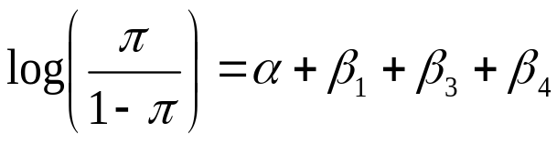
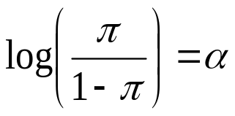
ANOVA with Interaction
Thus, the log(odds) for a baby girl is
The log(odds) for an adult male is

Slide 50
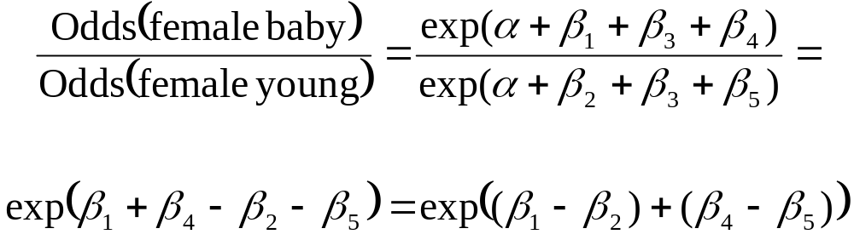
ANOVA-type models with Interaction
Typically, we would be interested in comparing different levels of one variable, at a fixed level of the other. For example, the odds ratio between the odds of eating pizza for female babies and the odds of eating pizza for female young people.
Note, we do not just exponentiate the difference between the corresponding categories of age but also the difference between the corresponding categories of the age by gender interaction.

Slide 51
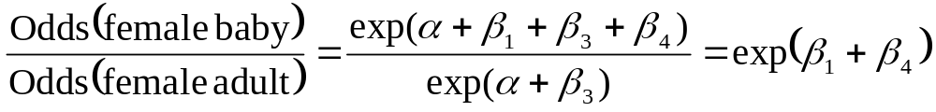
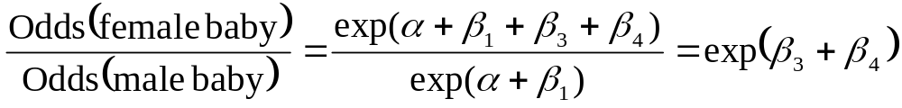
ANOVA-type models with Interaction
What is the ratio of the odds of eating pizza for female babies over the odds of eating pizza for female adults?
We may also be interested in describing the effect of gender, at a level of age. For example, what is the effect of gender for babies?

Slide 52
ANOVA-type models with Interaction
To test if the interaction should be in the model, we can test
H_{o}: β₄ = β₅ = 0
The likelihood ratio test compares the maximized loglikelihood L₁ for the full model with interaction to the maximized loglikelihood L₀ for the simpler model without interaction where those parameters equal 0.
The test statistic is -2(L₀– L₁) which has a chi-squared distribution with 2 degrees of freedom. The degrees of freedom are the difference in the number of parameters from the two models.

Slide 53
ANOVA-type models with Interaction
When there is interaction in the model, the interpretation of the Betas for the main effects is no longer valid.
First, when there is interaction, we describe the effects of the variables in terms of the interactions.
Also though, when using interaction, the main effects are not described and tested simply as the difference of the corresponding Betas.
For example, β_{young} no longer tests young vs the baseline age. With interaction in the model, β_{young} is testing young vs the baseline age at the baseline level of the other variable when that βeta is set to 0.
SAS:logreg2

Slide 54
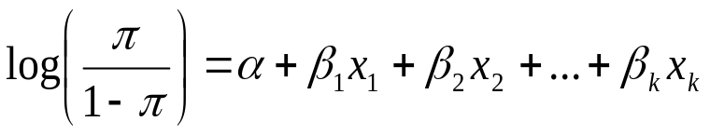
Multiple
Logistic Regression
A model can have several explanatory variables, which can be categorical, continuous, or both.
The parameter β_{i} refers to the effect of X_{i} on the log odds of success, controlling for the other predictors.
For example, exp(β₂) is the multiplicative effect of a 1 unit increase in X₂ on the odds of success, at fixed levels of the other predictors.

Slide 55
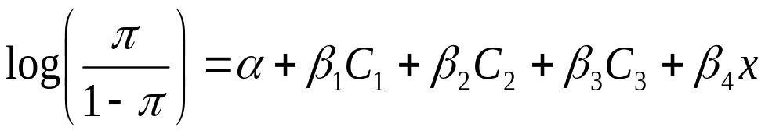
Multiple
Logistic Regression
Crab data: We now use color and width as explanatory variables.
Color is categorical and crabs fall into 1 of 4 groups: medium light, medium, medium dark, or dark.
Width is continuous. And the model is

Slide 56
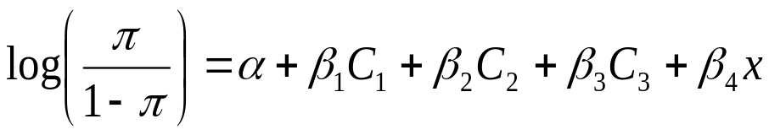
Multiple
Logistic Regression
C₁ = 1 if crab is medium light, 0 otherwise
C₂ = 1 if crab is medium, 0 otherwise
C₃ = 1 if crab is medium dark, 0 otherwise
We don’t have a parameter for dark crabs, which is the baseline level.
X is the width of the crab.

Slide 57
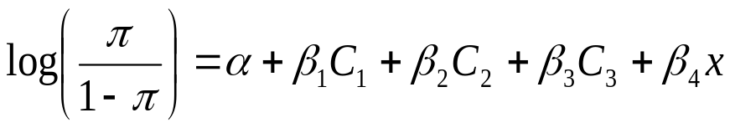
Multiple
Logistic Regression
 | mle | Standard Error
α(hat) | -12.71 | 2.76
β₁(hat) | 1.33 | 0.85
β₂(hat) | 1.4 | 0.55
β₃(hat) | 1.11 | 0.59
β₄(hat) | 0.468 | 0.11

Slide 58
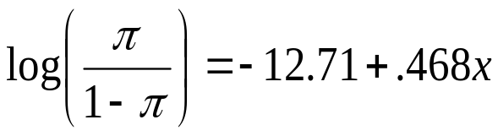
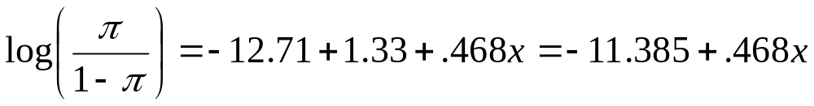
Multiple
Logistic Regression
For dark crabs:
For medium light crabs
The model assumes no interaction. The effect of width is the same for each color.

Slide 59
Multiple
Logistic Regression
As a result of no interaction, the shape of the S curve plotting the predicted probabilities is the same for each color (level of Z).
For each color, a 1 cm increase in width has a multiplicative effect on the odds ratio of exp(.468)
The different colors do not change the shape but they shift the S curve left or right.

Slide 60
Multiple
Logistic Regression
The shape is determined by the slope, which is the effect width has on the predicted probabilities.
In general, categorical variables shift locations of regression curves and continuous variables determine the slope.
If there was interaction, then the shapes of the curves for the different colors would be different.

Slide 61
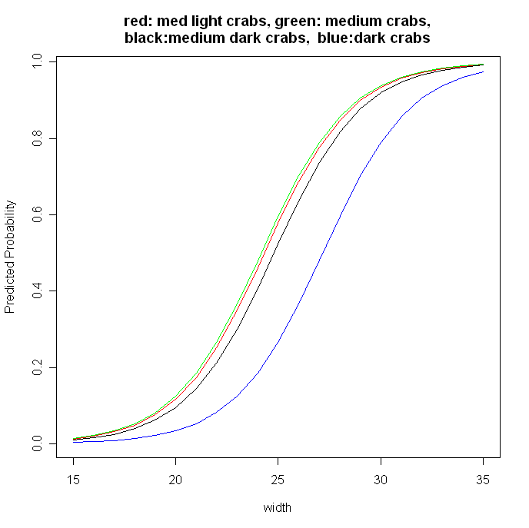

Slide 62
Multiple
Logistic Regression
 | mle | SE
α(hat) | -12.71 | 2.76
β₁(hat) | 1.33 | 0.85
β₂(hat) | 1.4 | 0.55
β₃(hat) | 1.11 | 0.59
β₄(hat) | 0.468 | 0.11
Calculate the estimated odds ratio of having a satellite between medium light crabs and medium dark crabs at the mean width of x = 26.5.

Slide 63
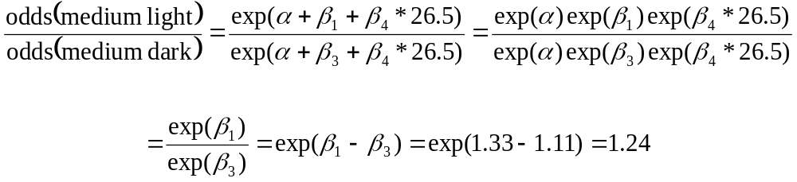
Multiple
Logistic Regression
The estimated odds ratio of having a satellite between medium light crabs and medium dark crabs at the mean width of x = 26.5 =
With no interaction, the exponentiated difference between two color parameter estimates is the odds ratio comparing those colors. This is the odds ratio, regardless of the value of width.

Slide 64
Multiple
Logistic Regression
To test if terms are needed in a model, we can compare the maximized loglikelihood values for that model and the simpler model without those terms.
To test whether color contributes to the model, we can test
H_{o}: β₁ = β₂ = β₃=0
This tests, controlling for width, if the probability of a satellite is independent of color.

Slide 65
Multiple
Logistic Regression
The likelihood ratio test compares the maximized loglikelihood L₁ for the full model with color to the maximized loglikelihood for the simpler model L₀ without color where those parameters equal 0.
The test statistic is -2(L₀– L₁) = 7.
What are the degrees of freedom?
There is a difference of 3 parameters, so the statistic has a chi-squared distribution with df=3. (P=.07)
SAS:logreg2

Slide 66
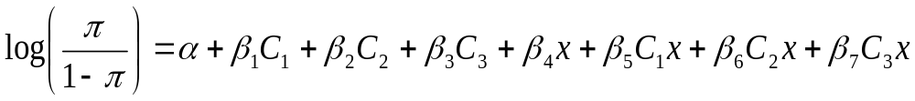
Multiple
Logistic Regression
We can allow for interaction between width and color by adding cross products of the terms for color and width.
The full model then looks like

Slide 67
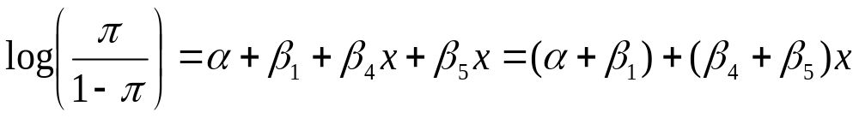

Multiple
Logistic Regression
If a crab has medium light (c1) color, the model looks like
If a crab has medium (c2) color, what does model look like?

Slide 68
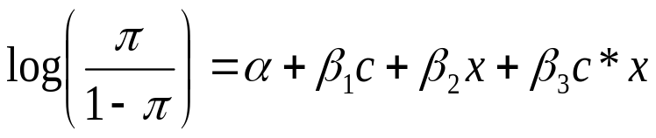
Multiple
Logistic Regression
Each color then has a different slope and a different S shaped curve of predicted probabilities.
The comparison of two colors then depends on the value of the width.
Consider a model that has only “not dark” or “dark” crabs (c=0 for dark crabs).

Slide 69
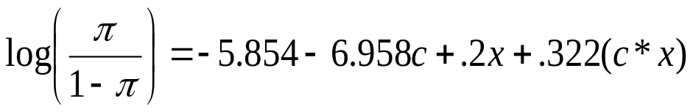
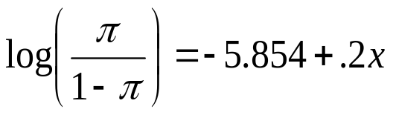
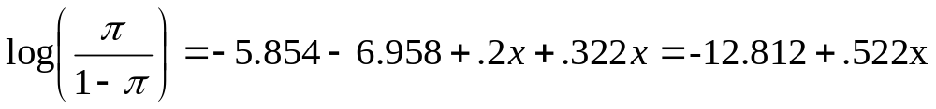
Multiple
Logistic Regression
The fitted model is
For dark crabs,
For not dark crabs,

Slide 70
Multiple
Logistic Regression
The curve for not dark crabs has a faster rate of increase. They cross at a point such that -5.854 + .2x = -12.812+.522x. That is x=21.6.
So at this value of x and greater, the not dark crabs have a higher estimated probability of having a satellite.
The sample widths range from 21 to 33.5, and the not dark crabs have a higher estimated probability over most of this range.

Slide 71
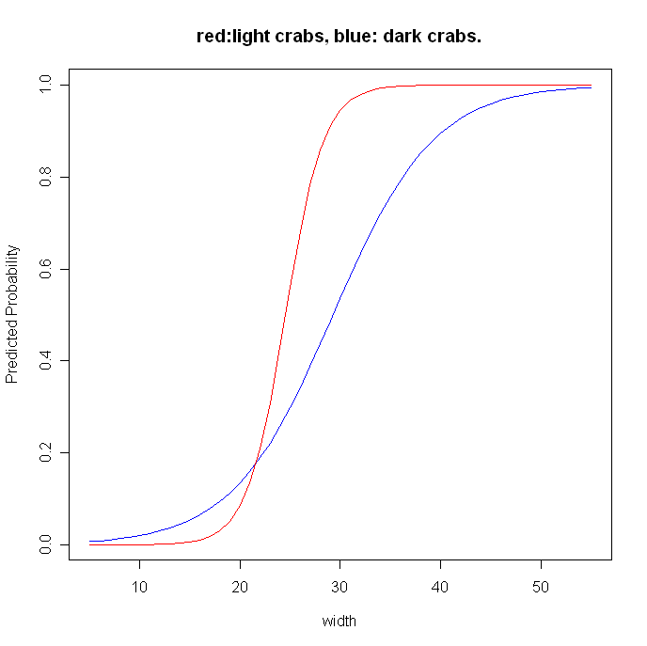

Slide 72
Multiple
Logistic Regression
The comparison of two colors then depends on the value of the width.
The odds ratio at the mean width (x=26.5) is

Slide 73
Multiple
Logistic Regression
What is the odds ratio at the max width (x=33.5)?

Slide 74
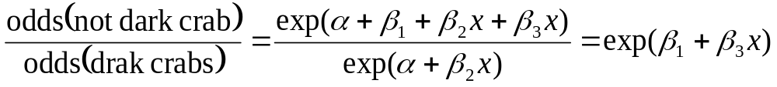
Multiple
Logistic Regression
For this example, we have that the odds ratio is
which depends on the value of x. This is a result of the interaction between x (shell width) and color.

Slide 75
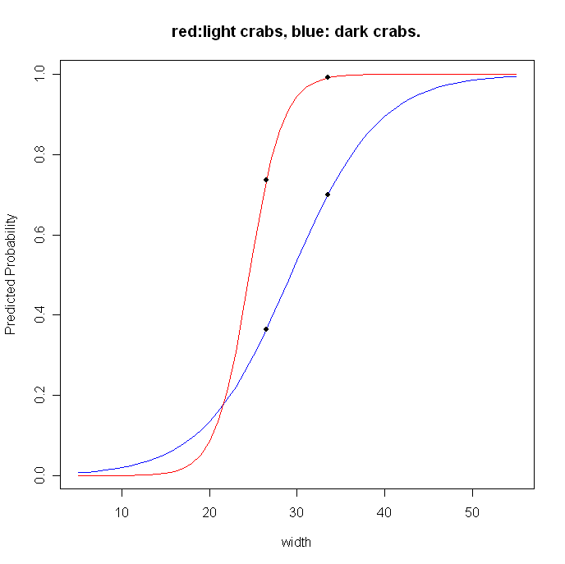

Slide 76
Multiple
Logistic Regression
Note even though the probabilities are closer together at x=33.5, the odds ratio is larger at this value.
At x=26.5, for dark crabs p=.365 and for light crabs p=.735 and OR=.735/(1-.735)/ .365(1-.365) = 2.77 / .574 =4.83
At x=33.5, for dark crabs p= .699 and for light crabs p=.99 and OR=.99/(1-.99)/ .699(1-.699) = 107.23/2.33=46

Slide 77
Multiple
Logistic Regression
To test for interaction we can compare this model to the simpler model without interaction. (Note, since here we are still using just dark and not dark for the colors, we can also just use the Wald test that β₃=0).
The null is the simpler model fits the data.
We use a likelihood ratio statistic based on the maximized likelihoods of the two models: L_{o} for the constraint that the interaction β₃=0 and L₁ for no constraint.
SAS:logreg2

